Slide 1
STAT 7900: Special Topic:
Causal Analysis
Instructor
Dhrubajyoti Ghosh
KENNESAW STATE UNIVERSITY
STAT 7900

Slide 2
Before Any Estimator: Define the Causal Target
ATE = E[Y(1) − Y(0)]
Population
Treatment & comparator
Outcome & time
What intervention versus what alternative?
What endpoint, measured when?
Whose effect do we want?
Estimator choice comes after the estimand and identification assumptions.

Slide 3

The Common Identification Assumptions
Consistency
Exchangeability
Positivity
No interference
Observed Y equals the potential outcome under the treatment actually received.
Both treatments are possible within relevant X profiles.
One unit’s treatment does not alter another unit’s outcome.
$$Y(t) ⟂ T | X$$
These methods estimate causal effects only after identification is justified.

Slide 4
Recap: Four Ways to Estimate Causal Effects
g-computation
PSM
IPW
AIPW
Model outcomes and predict both treatment worlds.
Select comparable observed treatment and control units.
Combine outcome predictions with weighting corrections.
Reweight observed units to construct a pseudo-population.
Different estimators • same causal identification problem

Slide 5
One Causal Question: Four Estimation Strategies
g-computation
PSM
IPW
AIPW
Use X to model Y.
Predict Y(1) and Y(0).
Average the contrast.
Use X to model T.
Find comparable units.
Compare matched outcomes.
Use X to model T.
Create inverse-probability weights.
Compare weighted outcomes.
Model both Y and T.
Predict outcomes.
Add weighted residual corrections.
The key distinction: model outcomes, redesign the sample, reweight the sample, or combine models.

Slide 6
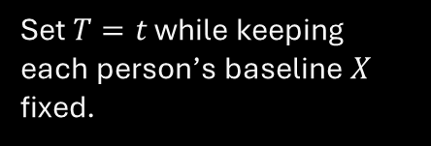
g-Formula: Identification Comes First
$$E\left[Y\left(t\right)\right]=E_{X}\{ E[Y | T=t, X] \}$$
Within X
Intervene conceptually
Standardize
Use comparable observed units to estimate the treatment-specific mean.
Set $T=t$ while keeping each person’s baseline $X$ fixed.
Average over one common target distribution of X.
The DAG and assumptions justify replacing missing counterfactual means with observed-data quantities.

Slide 7
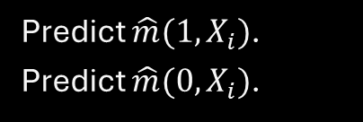
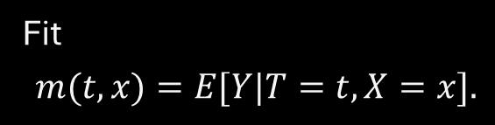
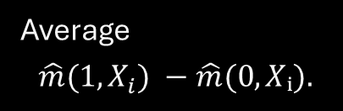
g-Computation: Predict Two Worlds for Everyone
Step 1
Step 2
Step 3
Fit
$$m(t,x)=E[Y|T=t,X=x].$$
Average
$$\hat{m}(1,X_{i}) −\hat{m}(0,Xᵢ).$$
Predict $\hat{m}(1,X_{i})$.
Predict $\hat{m}(0,X_{i})$.
$${\hat{τ}}_{g} = n^{-1}Σ_{i} \{\hat{m}(1,X_{i}) −\hat{m}(0,X_{i})\}$$

Slide 8
g-Computation in R: The Logic
Code
What each line means
fit <- lm(re78 ~ treat + age + educ + race + married +
nodegree + re74 + re75, data = d)
y1 <- predict(fit, transform(d, treat = 1))
y0 <- predict(fit, transform(d, treat = 0))
mean(y1 - y0)
Fit an outcome model.
Create the all-treated prediction world.
Create the all-control prediction world.
Average the individual predicted contrasts.
Main vulnerability: outcome-model misspecification.
In an additive linear model without T×X interaction, the g-computation ATE equals the treatment coefficient.

Slide 9

PSM: Construct Comparison Before Outcomes
$$e(X) = P(T=1 | X)$$
Estimate $e(X)$
Match
Check balance
Summarize treatment assignment using baseline covariates.
The matched groups should be similar on measured baseline X.
Find treated and control units with similar scores.
Matching uses observed comparison people to support the missing counterfactual outcome.

Slide 10
Nearest Neighbor, Calipers, and Target Population
Nearest neighbor
Caliper
Estimand
Treated-to-control matching often targets ATT or the effect among retained treated units.
Choose the control with the closest propensity score.
Reject matches that are still too far apart.
A better match can mean a smaller, but more defensible, target population.

Slide 11
Matching Is Not Finished When the Algorithm Stops
Balance
Overlap / retention
Inference
Check standardized mean differences on baseline covariates.
How many units were discarded? Where is common support?
Respect matched pairs, replacement, and unequal matching weights.
A small propensity-score gap is only a starting point; covariate balance determines usefulness.

Slide 12
IPW: Keep Units, Change Their Contribution
ATE weights: treated - $1/e(X)$ • control - $1/\{1−e(X)\}$
Rare observed assignment
Common observed assignment
Goal
Create a weighted pseudo-population with comparable baseline X.
Gets a larger weight.
Gets a smaller weight.
Think survey sampling: low-probability observations represent more of the target population.

Slide 13
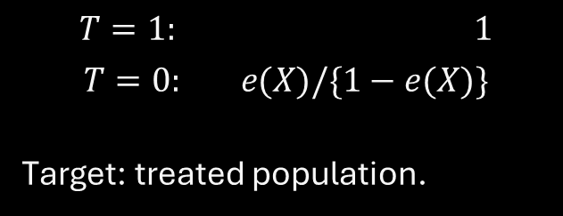
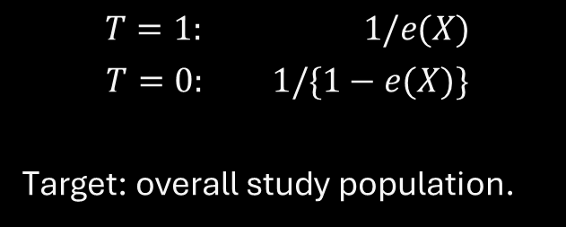
ATE and ATT Weights Target Different Populations
ATE weights
ATT weights
$$T=1: 1/e(X)$$
$$T=0: 1/\{1−e(X)\}$$
Target: overall study population.
$$T=1: 1$$
$$T=0: e(X)/\{1−e(X)\}$$
Target: treated population.
Same data + same propensity model + different weights = different causal question.

Slide 14
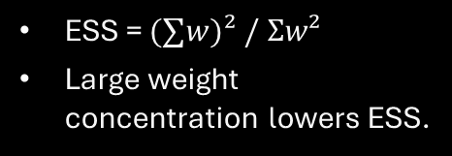
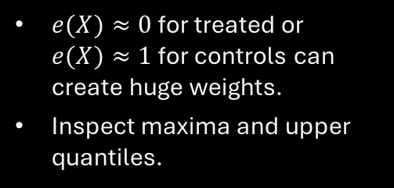
IPW Diagnostics: Do the Weights Behave?
Extreme weights
Effective sample size
Balance after weighting
$e(X)≈0$ for treated or $e(X)≈1$ for controls can create huge weights.
Inspect maxima and upper quantiles.
ESS = $(∑w)² / Σw²$
Large weight concentration lowers ESS.
Recalculate SMDs using weights.
Good code execution is not enough.
Stabilization rescales weights; it does not repair poor overlap.

Slide 15
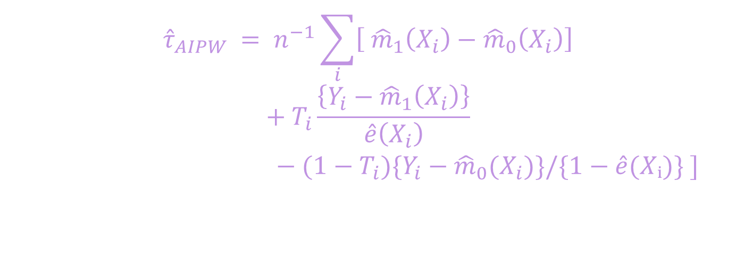
AIPW Formula: Read It in Pieces
$${\hat{τ}}_{AIPW} = n^{−1}\sum_{i}{\left[ {\hat{m}}_{1}\left(X_{i}\right)−{\hat{m}}_{0}\left(X_{i}\right)\right]}$$
$$+ T_{i}\frac{\left\{Y_{i}−{\hat{m}}_{1}\left(X_{i}\right)\right\}}{\hat{e}\left(X_{i}\right)}$$
$− (1−T_{i})\{Y_{i}−{\hat{m}}_{0}(X_{i})\}/\{1−\hat{e}(Xᵢ)\} ]$
Prediction contrast
Treated correction
Control correction
What the outcome model says.
Observed treated residuals, reweighted.
Observed control residuals, reweighted.
No need to memorize the entire expression: remember prediction + two residual corrections.

Slide 16
Double Robustness: What It Means
What it means
What it does NOT mean
Under standard conditions, AIPW remains consistent if:
• the outcome model is correct, OR
• the propensity model is correct.
It does not fix:
• unmeasured confounding
• lack of positivity
• two badly misspecified nuisance models
Double robustness protects against one nuisance-model misspecification—not every causal failure.

Slide 17
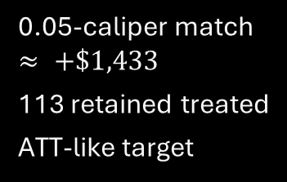
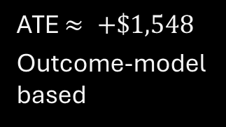
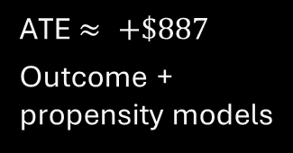
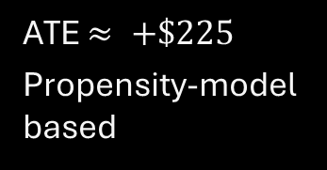
Same Job-Training Data: Different Answers
g-computation
PSM
Normalized IPW
AIPW
ATE $≈ +\$1,548$
Outcome-model based
0.05-caliper match $≈ +\$1,433$
113 retained treated
ATT-like target
ATE $≈ +\$225$
Propensity-model based
ATE $≈ +\$887$
Outcome + propensity models
Do not compare the numbers blindly: PSM here targets a retained-treated population, whereas the other three shown target the overall study-population ATE.

Slide 18
One-Slide Comparison
Feature | g-computation | PSM | IPW | AIPW
Main model | Outcome model | Propensity model | Propensity model | Outcome + propensity
How comparison is built | Predict both worlds | Select comparable units | Reweight units | Predict + weighted correction
Keeps all units? | Usually yes | Often no | Usually yes | Usually yes
Typical target | ATE / ATT by standardization | Often ATT-like | ATE or ATT | ATE or ATT
Main diagnostic | Outcome-model adequacy | Balance + overlap | Weights + ESS + balance | Both model & weight diagnostics
Main vulnerability | Outcome misspecification | Poor matches / support | Extreme weights / PS misspecification | Both models wrong; poor overlap

Slide 19
How Should I Choose Among Them?
Prefer g-computation when
Prefer PSM / IPW when
Prefer AIPW when
You can model the outcome well.
You want flexible standardization.
Interactions / nonlinear response surfaces are scientifically central.
Design-stage comparability is central.
You want explicit balance diagnostics.
You can defend a useful treatment-assignment model.
You want both nuisance models.
You can diagnose both sides.
You may use flexible nuisance estimators with cross-fitting.
There is no automatic winner: estimand, overlap, data structure, and modeling credibility matter.

Slide 20


Slide 21
From ATE to Heterogeneous Treatment Effects
So far
Now
Goal
Most of our estimators have targeted one average effect.
Ask whether the effect changes across baseline characteristics X.
Move from ATE to conditional average treatment effects.
ATE $→$ CATE(x) $→$ treatment-effect heterogeneity

Slide 22
Why Average Treatment Effect Can Hide the Story
Group A
Group B
Group C
Treatment effect = +10
Treatment effect = 0
Treatment effect = −10
A single overall average can conceal benefit, no effect, and harm.
A small or zero ATE does not imply that treatment is unimportant for everyone.

Slide 23

ATE vs CATE
$$ATE = E[Y(1) − Y(0)]$$
$$CATE(x) = E[Y(1) − Y(0) | X=x]$$
ATE
CATE
Possible X
How much does treatment help in the target population, on average?
How much does treatment help for people with a particular X profile?
Age • severity • biomarker • baseline risk • prior outcome
ATE averages over X. CATE conditions on X.
A small or zero ATE does not imply that treatment is unimportant for everyone.

Slide 24
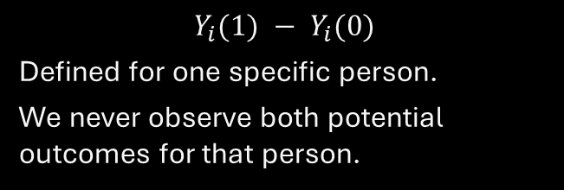
CATE Is Still an Average
Individual treatment effect
$$CATE(x)$$
$$Y_{i}(1) − Y_{i}(0)$$
Defined for one specific person.
We never observe both potential outcomes for that person.
Average effect among people with X=x.
Still a population-level quantity.
More local than the ATE, but not a deterministic prediction for one person.
“Patients like this benefit by 8 units on average” $≠$ “this patient will benefit by exactly 8.”

Slide 25
Effect Modifier vs Confounder
Confounder
Effect modifier
Affects treatment assignment and outcome.
Creates a backdoor path.
Threatens identification.
Question: what must we adjust for?
Changes the magnitude or direction of the treatment effect.
Does not have to cause treatment.
Question: for whom is the effect different?
Confounding is about bias. Effect modification is about genuine variation in the causal effect.

Slide 26
Effect Modifier vs Confounder
Example: Age
Confounding role
Effect-modification role
Older patients may be more likely to receive treatment.
Age may also predict the outcome even without treatment.
The biological treatment response may also differ by age.
One X can matter for identification AND for heterogeneity.
Adjusting for age removes confounding; an interaction with age investigates whether the effect itself varies.

Slide 27
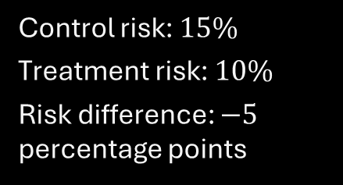
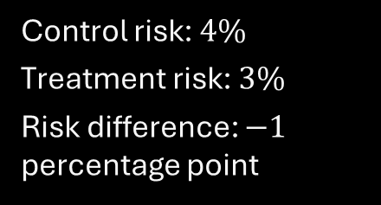
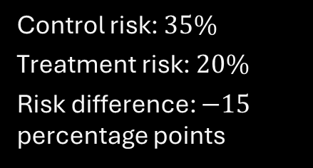
Real-World Example
Low-risk patients
Medium-risk patients
High-risk patients
Control risk: $4\%$
Treatment risk: $3\%$
Risk difference: $−1$ percentage point
Control risk: $15\%$
Treatment risk: $10\%$
Risk difference: $−5$ percentage points
Control risk: $35\%$
Treatment risk: $20\%$
Risk difference: $−15$ percentage points
Same treatment, but much larger absolute benefit in higher-risk patients.

Slide 28
Real-World Heterogeneity Across Fields
Medicine
Education
Policy
Cancer therapy by biomarker status
Drug benefit by baseline cardiovascular risk
Benefit-to-harm balance by frailty
Tutoring by prior achievement
Class-size reduction by baseline performance
Technology interventions by access
Job training by prior earnings
Cash transfers by baseline income
Policy effects by region
HTE turns “Does it work?” into “Where, for whom, and how much?”

Slide 29
What Counts as Evidence of Heterogeneity?
Not enough
Better evidence
Best practice
Treatment is significant in one subgroup but not another.
Two subgroup point estimates look visually different.
Directly test an interaction.
Estimate the difference in treatment effects.
Report uncertainty for that difference.
Use pre-specified modifiers when possible.
Avoid data-driven subgroup fishing.
Validate exploratory findings.
The question is whether treatment effects differ, not whether two separate p-values differ.

Slide 30
Next: Model the Treatment Effect as a Function of X
$$τ(x) = E[Y(1) − Y(0) | X=x]$$
Classical approach
Flexible approach
Modern approach
Treatment × covariate interactions
S-, T-, and X-learners
Causal forests and data-adaptive CATE estimation
Next section: Classical THE, subgroup effects and interaction models.

Slide 31
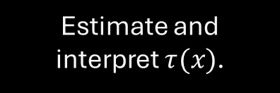
Classical HTE: Interaction Models
Average-effect model
Interaction model
Target
One treatment coefficient for everyone.
Allow treatment effect to depend on X.
Estimate and interpret $τ(x)$.
one effect → treatment × covariate interaction → effect curve

Slide 32
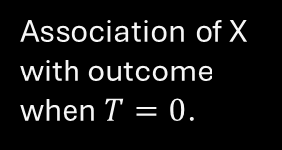


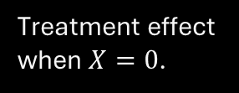

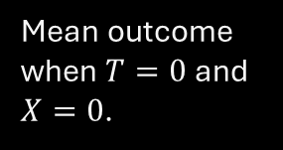

The Basic Interaction Model
$$E[Y | T,X] = β₀ + β₁T + β₂X + β₃(T×X)$$
$$β₀$$
$$β₁$$
$$β₂$$
$$β₃$$
Mean outcome when $T=0$ and $X=0$.
Treatment effect when $X=0$.
Association of X with outcome when $T=0$.
How the treatment effect changes as X changes.
The interaction coefficient $β₃$ is the key parameter for classical HTE.

Slide 33

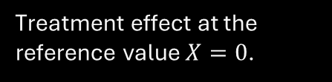

Deriving the Conditional Treatment Effect
$$m(1,x) = β₀ + β₁ + β₂x + β₃x$$
$$m(0,x) = β₀ + β₂x$$
$$τ(x) = m(1,x) − m(0,x) = β₁ + β₃x$$
$$β₁$$
$$β₃$$
Treatment effect at the reference value $X=0$.
Change in treatment effect for a one-unit increase in X.

Slide 34

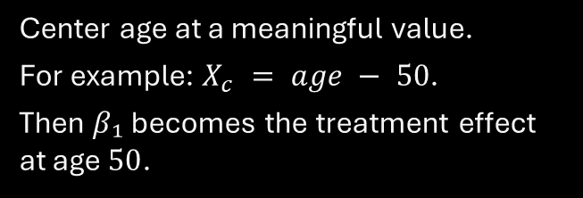
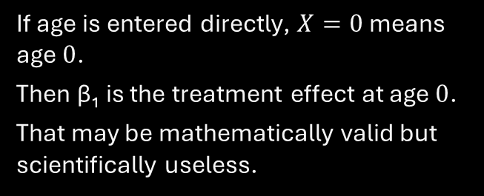
What Does $β₁$ Mean? The Reference Value Matters
Suppose $X = age$
Better strategy
If age is entered directly, $X=0$ means age $0$.
Then β₁ is the treatment effect at age $0$.
That may be mathematically valid but scientifically useless.
Center age at a meaningful value.
For example: $X_{c} = age − 50$.
Then $β₁$ becomes the treatment effect at age $50$.
Main lesson: with an interaction, the 'treatment coefficient' is conditional on the coding of X.

Slide 35



What Does $β₃$ Mean?
τ(x+1) − τ(x) = β₃
$$β₃ > 0$$
$$β₃ = 0$$
$$β₃ < 0$$
Treatment benefit becomes more positive as X increases.
No evidence of linear effect modification by X.
Treatment effect becomes less positive or more harmful as X increases.
$β₃$ describes a difference in effects, not merely a difference in outcomes.

Slide 36
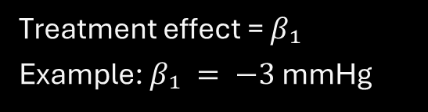
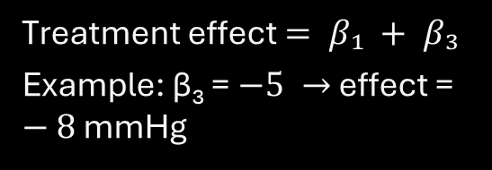

Binary Effect Modifier: Diabetes Status
$$E[Y|T,D] = β₀ + β₁T + β₂D + β₃(T×D)$$
D = 0: no diabetes
$D = 1$: diabetes
Treatment effect = $β₁$
Example: $β₁ = −3$ mmHg
Treatment effect $= β₁ + β₃$
Example: β₃ = $−5 →$ effect = $−8$ mmHg
The interaction asks whether the treatment effect differs by diabetes status.

Slide 37
Worked Example: Read the Interaction
Group | Control mean | Treatment mean | Effect
No diabetes | 130 | 127 | −3
Diabetes | 145 | 137 | −8
Difference in treatment effects = $(−8) − (−3) = −5$
That difference corresponds to the interaction coefficient β₃.

Slide 38
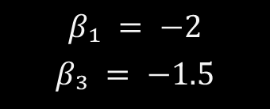
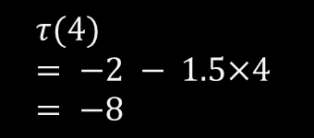

Continuous Effect Modifier: Baseline Severity
$$τ(x) = β₁ + β₃x$$
Example coefficients
At X = 0
At X = 4
$$τ(0) = −2$$
$$τ(4) = −2 − 1.5×4 = −8$$
$$β₁ = −2$$
$$β₃ = −1.5$$
A negative $β₃$ means the treatment becomes increasingly beneficial as severity increases, when lower Y is better.

Slide 39








Treatment Effect as a Function
$$X = 0$$
$$X = 1$$
$$X = 2$$
$$X = 4$$
$$τ(0) = −2$$
$$τ(1) = −3.5$$
$$τ(2) = −5$$
$$τ(4) = −8$$
For a continuous modifier, avoid forcing everyone into arbitrary 'low' and 'high' groups.
Better: estimate and plot τ(x) across the clinically relevant range of X.

Slide 40
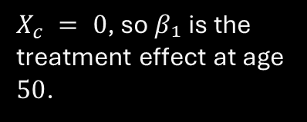
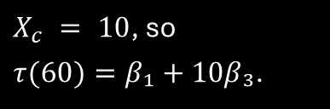
Centering a Continuous Modifier
$$X_{c} = X − 50$$
At age 50
At age 60
Why this helps
$X_{c} = 0$, so $β₁$ is the treatment effect at age $50$.
$X_{c} = 10$, so
$τ(60)=β₁+10β₃$.
Main-effect coefficients become interpretable at a meaningful reference point.
Centering changes interpretation, not the fitted values or evidence for interaction.
Better: estimate and plot τ(x) across the clinically relevant range of X.

Slide 41
R: Fit and Read an Interaction Model
Code
Interpretation
d$age50 <- d$age - 50
fit <- lm(Y ~ treat * age50 + sex + baseline_risk, data = d)
summary(fit)
coef(fit)[c("treat", "treat:age50")]
treat = estimated effect at age 50.
treat: age50 = change in treatment effect per one-year increase in age.
Other baseline covariates can still be included for confounding adjustment / precision.
Do not interpret the interaction model by looking only at the p-value for treat.

Slide 42
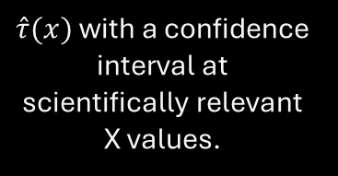
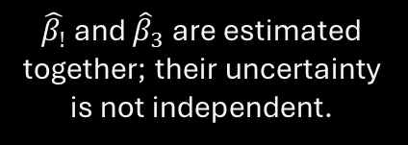
Uncertainty for $τ(x)$
$$\hat{τ}\left(x\right)={\hat{β}}_{1}+ x {\hat{β}}_{3}$$
$$Var\left\{\hat{τ}\left(x\right)\right\} = Var\left({\hat{β}}_{1}\right) + x^{2}Var\left({\hat{β}}_{3}\right) + 2xCov\left({\hat{β}}_{1},{\hat{β}}_{3}\right)$$
Why covariance matters
What to report
What to plot
$\hat{τ}(x)$ with a confidence interval at scientifically relevant X values.
Effect curve plus uncertainty band across the supported range of X.
$\hat{β_{!}}$ and ${\hat{β}}_{3}$ are estimated together; their uncertainty is not independent.
Do not extrapolate the interaction effect far beyond the observed range of X.

Slide 43
A Mistake: 'Significant Here, Not Significant There'
Subgroup A
Subgroup B
Treatment effect = −6
95% CI: [−10, −2]
p = 0.01
Treatment effect = −4
95% CI: [−9, 1]
p = 0.11
Can we conclude the effects differ? NO.
The correct question is whether (effect A − effect B) differs from zero.

Slide 44
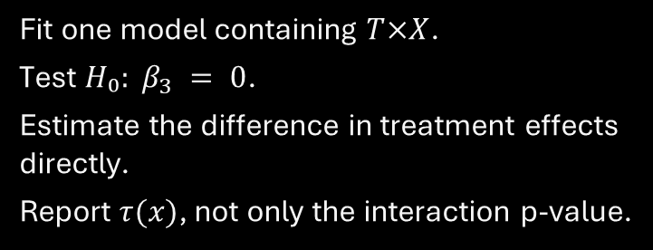
Correct HTE Test, and the Limit of One Interaction
Correct classical test
Where this becomes difficult
Fit one model containing $T×X$.
Test $H₀: β_{3} = 0$.
Estimate the difference in treatment effects directly.
Report $τ(x)$, not only the interaction p-value.
Many possible modifiers.
Nonlinear treatment-effect patterns.
Higher-order interactions.
Data-driven discovery without massive subgroup fishing.
Next: flexible CATE estimation with S-, T-, X-learners and causal forests.

Slide 45
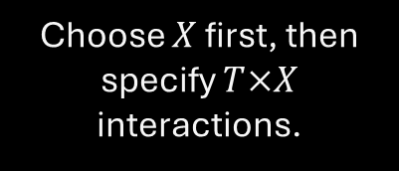
Modern CATE Estimation
Classical HTE
Modern HTE
Goal
Choose $X$ first, then specify $T×X$ interactions.
Let flexible prediction models learn complex response surfaces.
Estimate τ(x) without assuming a simple linear interaction.
Outcome learning $→$ counterfactual prediction $→$ CATE estimation

Slide 46
Why Not Just Add More Interactions?
Many modifiers
Complex shapes
Statistical cost
Age
Biomarkers
Baseline risk
Comorbidities
Prior outcomes
Nonlinear effects
Thresholds
Higher-order interactions
Unknown functional form
Many parameters
Low power
Overfitting
Multiplicity
Modern HTE methods trade rigid parametric structure for flexible nuisance and CATE estimation.

Slide 47
Meta-Learners: Use Prediction Algorithms
Base learner
Meta-learner
Causal target
Regression, random forest, boosting, neural network, etc.
A recipe for organizing one or more prediction models around treatment and outcome.
Convert those predictions into an estimate of τ(x).
The S-, T-, and X-learners are strategies, not specific machine-learning algorithms.

Slide 48
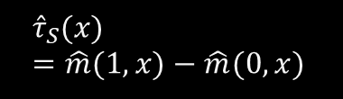
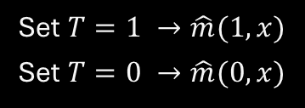
S-Learner: One Outcome Model
$$m(t,x) = E[Y | T=t, X=x]$$
Fit once
Predict twice
Subtract
Use T and X together in one flexible prediction model.
Set $T=1 →\hat{m}(1,x)$
Set $T=0 →\hat{m}(0,x)$
$${\hat{τ}}_{S}(x)=\hat{m}(1,x)−\hat{m}(0,x)$$
S = single model.

Slide 49
S-Learner: Strengths and Weaknesses
Strengths
Weaknesses
Simple workflow
Shares information across treatment arms
Can use powerful nonlinear learners
Works naturally with many X
Treatment may be ignored if X predicts Y strongly
Regularization can shrink treatment interactions
One model may underrepresent true arm-specific structure
Good outcome prediction does not automatically imply good CATE estimation.

Slide 50
R Logic for an S-Learner
Conceptual code
What matters
fit_s <- learner(Y ~ treat + X1 + X2 + ..., data=d)
d1 <- transform(d, treat=1)
d0 <- transform(d, treat=0)
tau_s <- predict(fit_s, d1) - predict(fit_s, d0)
The learner must allow treatment to interact with X somehow.
A plain additive linear model produces no heterogeneity unless interactions are included.
Flexible learners can learn interactions implicitly.
Prediction under two treatment worlds is the same g-computation idea, now used locally for τ(x).

Slide 51
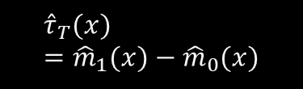
T-Learner: Two Outcome Models
$m₁(x)=E[Y|T=1,X=x]$ and $m₀(x)=E[Y|T=0,X=x]$
Treated model
Control model
Subtract
Fit a model using only treated units.
Fit a separate model using only control units.
$${\hat{τ}}_{T}(x)={\hat{m}}_{1}(x)−{\hat{m}}_{0}(x)$$
T = two models.

Slide 52
T-Learner: When Separate Models Help, and Hurt
Why it can help
Why it can hurt
Treatment and control response surfaces may be very different.
Each arm can learn its own nonlinearities.
No need to encode treatment interactions explicitly.
Each model sees fewer observations.
Severe treatment imbalance can make one model unstable.
Errors from two separate models accumulate in τ̂(x).
The T-learner favors flexibility across arms but sacrifices information sharing.

Slide 53
S-Learner vs T-Learner: The Key Tradeoff
S-Learner
T-Learner
1 model
More information sharing
Potentially smoother / more stable
May shrink heterogeneity toward zero
2 models
Less information sharing
Allows very different response surfaces
Can be unstable in small treatment arms
Bias–variance tradeoff appears in CATE estimation too.

Slide 54
X-Learner: Imputed Treatment Contrasts
1. Fit outcomes
2. Impute effects
3. Model effects
4. Combine
Estimate m̂₁(x) and m̂₀(x).
Construct a pseudo-effect for each observed unit.
Learn treatment-effect patterns as functions of X.
Blend arm-specific effect models.
The X-learner explicitly creates proxy outcomes for the missing treatment effect.

Slide 55
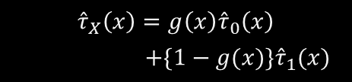
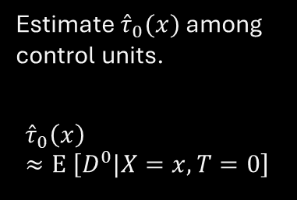

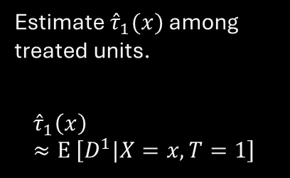

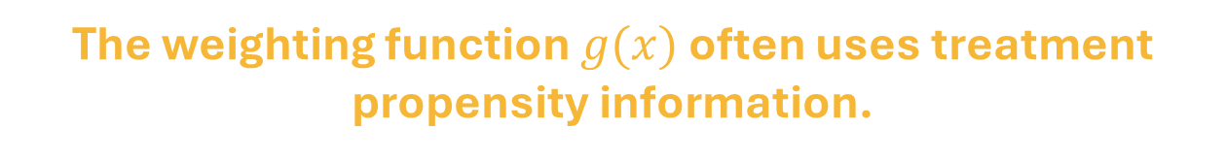
X-Learner: The Four Steps
For treated: $D¹ = Y −{\hat{m}}_{0}(X)$
For controls: $D⁰ ={\hat{m}}_{1}(X) − Y$
Then model $D¹$
Model $D⁰$
Combine
Estimate ${\hat{τ}}_{1}(x)$ among treated units.
$${\hat{τ}}_{1}\left(x\right)≈E \left[D^{1}|X=x, T=1\right]$$
Estimate ${\hat{τ}}_{0}(x)$ among control units.
$${\hat{τ}}_{0}\left(x\right)≈E \left[D^{0}|X=x, T=0\right]$$
$${\hat{τ}}_{X}\left(x\right)=g\left(x\right){\hat{τ}}_{0}\left(x\right)$$
$+\{1−g(x)\}{\hat{τ}}_{1}(x)$
The weighting function $g(x)$ often uses treatment propensity information.

Slide 56
When Is the X-Learner Attractive?
Treatment imbalance
Structured heterogeneity
Caution
One arm may be much larger than the other.
Still depends on accurate nuisance learning and adequate local overlap.
Treatment effects may be simpler than outcome surfaces.
X-learning can borrow strength strategically; it cannot manufacture missing support.

Slide 57
Comparison: S-, T-, and X-Learners
Feature | S-Learner | T-Learner | X-Learner
Outcome models | 1 | 2 | 2 initial + effect models
Information sharing | High | Low | Intermediate / adaptive
Treatment imbalance | Can be stable | Can struggle | Often attractive
Main idea | Predict both worlds from one model | Separate response surfaces | Impute and learn treatment effects
Main risk | Treatment signal shrunk | Small-arm instability | More modeling stages
None is uniformly best; performance depends on sample size, imbalance, smoothness, and the base learner.

Slide 58
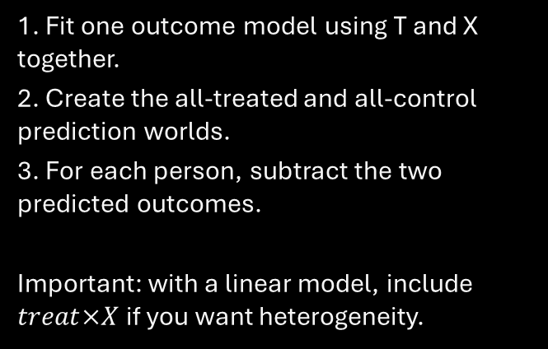
R Code: S-Learner
Code
How to read it
fit_s <- lm(
re78 ~ treat * (age + educ + re74 + re75),
data = d
)
d1 <- transform(d, treat = 1)
d0 <- transform(d, treat = 0)
mu1_s <- predict(fit_s, newdata = d1)
mu0_s <- predict(fit_s, newdata = d0)
tau_s <- mu1_s - mu0_s
summary(tau_s)
1. Fit one outcome model using T and X together.
2. Create the all-treated and all-control prediction worlds.
3. For each person, subtract the two predicted outcomes.
Important: with a linear model, include $treat×X$ if you want heterogeneity.

Slide 59
R Code: T-Learner
Code
How to read it
fit1 <- lm(
re78 ~ age + educ + re74 + re75,
data = d[d$treat == 1, ]
)
fit0 <- lm(
re78 ~ age + educ + re74 + re75,
data = d[d$treat == 0, ]
)
mu1_t <- predict(fit1, newdata = d)
mu0_t <- predict(fit0, newdata = d)
tau_t <- mu1_t - mu0_t
summary(tau_t)
1. Fit a treated-outcome model only among treated units.
2. Fit a control-outcome model only among control units.
3. Use both models to predict for the same person.
4. Subtract the two predicted outcomes.
This allows the treated and control response surfaces to differ.

Slide 60
R Code: X-Learner (Steps 1–2)
Code
How to read it
# Step 1: initial outcome models
fit1 <- lm(re78 ~ age + educ + re74 + re75,
data = d[d$treat == 1, ])
fit0 <- lm(re78 ~ age + educ + re74 + re75,
data = d[d$treat == 0, ])
m1 <- predict(fit1, newdata = d)
m0 <- predict(fit0, newdata = d)
# Step 2: imputed treatment effects
D1 <- d$re78[d$treat == 1] - m0[d$treat == 1]
D0 <- m1[d$treat == 0] - d$re78[d$treat == 0]
For treated units:
D1 = observed Y(1) − predicted Y(0)
For control units:
D0 = predicted Y(1) − observed Y(0)
These are pseudo-treatment effects.

Slide 61
R Code: X-Learner (Steps 3–4)
Code
How to read it
# Step 3: model the pseudo-effects
fit_tau1 <- lm(D1 ~ age + educ + re74 + re75,
data = d[d$treat == 1, ])
fit_tau0 <- lm(D0 ~ age + educ + re74 + re75,
data = d[d$treat == 0, ])
tau1 <- predict(fit_tau1, newdata = d)
tau0 <- predict(fit_tau0, newdata = d)
# Step 4: combine
ps_fit <- glm(treat ~ age + educ + re74 + re75,
family = binomial(), data = d)
e <- predict(ps_fit, type = 'response')
tau_x <- e * tau0 + (1 - e) * tau1
summary(tau_x)
1. Learn how the pseudo-effects vary with X.
2. Predict those effect models for everyone.
3. Combine the two effect-model predictions.
The propensity score helps decide how much weight to give each side.

Slide 62
Why Do We Need Another HTE Method?
S / T / X learners
What is still difficult?
A different idea
Learn outcome models and/or imputed effects.
Result depends on the choice and quality of base learners.
Many modifiers, nonlinear interactions, sparse subgroups, and data-driven searches for where effects differ.
Build local treatment–control comparisons around people with similar X, using trees designed for HTE.
Causal forest is an alternative CATE estimator, not a required successor to S/T/X.

Slide 63
Ordinary vs Causal Trees: What Should a Split Find?
Ordinary prediction tree
Causal tree
Split on X to make outcomes Y easier to predict.
Example: baseline severity predicts risk well, even when treatment effect is constant.
Split on X when there is evidence that treatment effects differ across the resulting groups.
Example: biomarker status changes the treated–control contrast.
Strong predictor of Y $≠$ strong modifier of treatment effect

Slide 64
Ordinary Random Forest Is Not a Causal Forest
Ordinary random forest
Causal forest
Goal: predict Y accurately.
Splits reduce outcome prediction error.
A strong prognostic variable may dominate even if it does not modify treatment effect.
Goal: estimate heterogeneity in treatment effects.
Splits seek regions with different treatment effects.
Treatment and control information are compared within leaves.
Prediction heterogeneity $≠$treatment-effect heterogeneity

Slide 65
Causal Forest: Intuition
Grow many trees
Look for effect differences
Average locally
Prefer splits that reveal treatment-effect heterogeneity rather than outcome levels alone.
Combine many trees to estimate τ(x) for each covariate profile.
Repeatedly partition covariate space into local neighborhoods.
Forest = adaptive local comparison + aggregation across many trees

Slide 66
Causal Forest: The Main Idea
1. Local groups
2. Local causal contrasts
3. Ensemble
Trees partition covariate space into neighborhoods of similar X.
Within neighborhoods, use observed treatment and outcome information to estimate effects.
Average information across many trees to produce a CATE estimate at x.
Unlike an ordinary forest, splitting is designed for treatment-effect heterogeneity.

Slide 67
Honest Trees: Choosing Splits
Without sample separation
Honest estimation
The same unusual outcomes can influence both the tree partition and the effect estimate.
This can exaggerate apparent heterogeneity.
Use one subsample to choose splits and another to estimate treatment effects in the selected leaves.
Reduces adaptive estimation bias.
Honesty helps with adaptive bias; it does not remove confounding or lack of overlap.

Slide 68
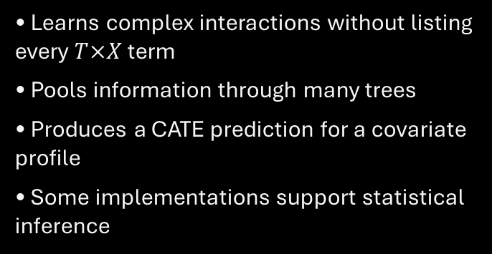
What Causal Forests Do and Do Not Guarantee
Useful features
Still required
• Learns complex interactions without listing every $T×X$ term
• Pools information through many trees
• Produces a CATE prediction for a covariate profile
• Some implementations support statistical inference
• A defensible causal design and adjustment set
• Adequate overlap and sample size
• Valid outcome and treatment coding
• Diagnostics and honest uncertainty reporting
A sophisticated algorithm does not identify a causal effect by itself.

Slide 69
R: Fit a Causal Forest with the LaLonde Data
R code
Explain in class
library(MatchIt)
library(grf)
data("lalonde", package = "MatchIt")
d <- lalonde
X <- model.matrix(
~ age + educ + race + married + nodegree + re74 + re75,
data = d)[, -1, drop = FALSE]
cf <- causal_forest(
X, Y = d$re78, W = d$treat, seed = 123
)
X: baseline covariate matrix
Y: 1978 earnings
W: training indicator
The forest estimates effects conditionally on X.
Requires package grf.

Slide 70
What Does Variation in Predicted CATEs Mean?
Possible signal
Possible noise
Needed next
The causal effect really differs across baseline covariate profiles.
Small subgroups, model instability, or finite-sample variability create apparent differences.
Calibration, uncertainty, external or honest validation, and overlap checks.
Prediction variability is a hypothesis about HTE, not a completed validation.

Slide 71
Can We Trust the Heterogeneity?
Calibration
Ranking
Support + uncertainty
Are estimated effects systematically too small or too large?
Do high-predicted-benefit groups show larger treatment effects in independent data?
Are estimates based on adequate treatment overlap and enough information?
Evaluate the CATE model, not only its ability to predict the observed outcome.

Slide 72
Why In-Sample HTE Patterns Can Mislead
Discover + evaluate on the same data
Use independent evidence
The model can search for spurious groups.
Examining the same observations again may make those groups look more convincing.
Train on one set and evaluate HTE on held-out data.
Cross-fitting can use each observation for evaluation without fitting its prediction on itself.
Exploratory subgroup discovery should be distinguished from confirmatory evidence.

Slide 73
Cross-Fitting: The Basic Workflow
Fold A
Fold B
Repeat
Fit models using data outside Fold A.
Predict CATE for Fold A.
Fit models using data outside Fold B.
Predict CATE for Fold B.
Every evaluated person receives a prediction from a model that did not train on their outcome.
Cross-fitting limits overfitting; it does not fix unmeasured confounding.

Slide 74
CATE Calibration: Does the Magnitude Make Sense?
Example
What calibration checks
Model predicts effects near −2 for low-risk patients and −10 for high-risk patients.
In independent evaluation data, do estimated treatment contrasts align with those magnitudes?
Whether stronger predicted effects correspond to stronger causal contrasts.
Needs an appropriate causal estimator and uncertainty, not raw outcome comparisons.
CATE calibration $≠$ ordinary outcome-prediction calibration.

Slide 75
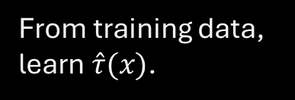
Ranking by Predicted Benefit
First
Second
Third
From training data, learn $\hat{τ}(x)$.
In held-out data, group units into low, medium, and high predicted benefit.
Estimate each group’s causal effect, with adjustment appropriate to the design.
Do not compare untreated outcomes with treated outcomes without a credible design.

Slide 76


Local Overlap: Some CATEs Are Harder to Learn
$$e(x) = P(T=1 | X=x)$$
At $e(x) ≈ 0.5$
At$e(x) ≈ 0.01$ or $0.99$
Treated and control observations are both reasonably represented nearby.
One treatment arm is rare; local counterfactual comparisons are weakly supported.
A forest cannot recover an unobserved treatment arm from modeling alone.

Slide 77
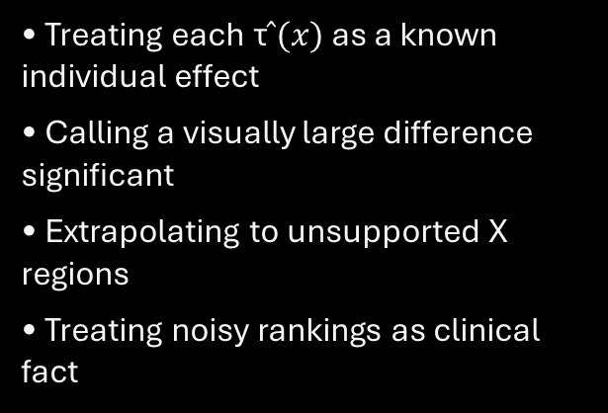
Uncertainty: Estimated CATE Not an Individual Truth
Report
Avoid
• Predicted treatment effects at relevant X
• Appropriate standard errors / intervals
• Uncertainty in subgroup differences
• Sample size and overlap diagnostics
• Treating each τ$̂(x)$ as a known individual effect
• Calling a visually large difference significant
• Extrapolating to unsupported X regions
• Treating noisy rankings as clinical fact
If intervals are wide, say the data are not informative enough about heterogeneity.

Slide 78
R: Useful Causal-Forest Diagnostics
R code
Important qualification
# Calibration diagnostic within grf
test_calibration(cf)
# Forest’s estimated average treatment effect
average_treatment_effect(cf)
# Treatment propensity estimated by forest
summary(cf$W.hat)
# Inspect CATE predictions
quantile(predict(cf)$predictions,
probs = c(.05, .25, .5, .75, .95))
test_calibration() is a model diagnostic—not external validation.
For a real HTE validation exercise, use independent/held-out comparisons and appropriate inference.

Slide 79
What Should Responsible HTE Results Include?
Design first
Method + diagnostics
Interpretation
Population and estimand
Treatment/outcome definitions
Measured confounders
Overlap assumptions
Model specification
Sample splitting / honesty
CATE plots and intervals
Calibration and stability
Magnitude and direction
Clinically/policy meaningful strata
Exploratory vs confirmatory
Unmeasured confounding caveat
Explain who benefits, how much, and how confidently—not just which algorithm won.

Slide 80
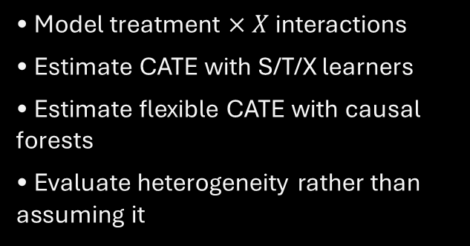
Final HTE Takeaways and the Next Causal Challenge
What we can now do
What remains unresolved
• Model treatment $× X$ interactions
• Estimate CATE with S/T/X learners
• Estimate flexible CATE with causal forests
• Evaluate heterogeneity rather than assuming it
All of these approaches require a defensible identification strategy.
What if treatment assignment depends on an important confounder U that was never measured?
Next: Unobserved Confounding and Sensitivity Analysis

